Slide 1

The Science, Politics and Morality of Climate Change
John R. Christy
Alabama State Climatologist
The University of Alabama in Huntsville
10 Nov 2016

Slide 2
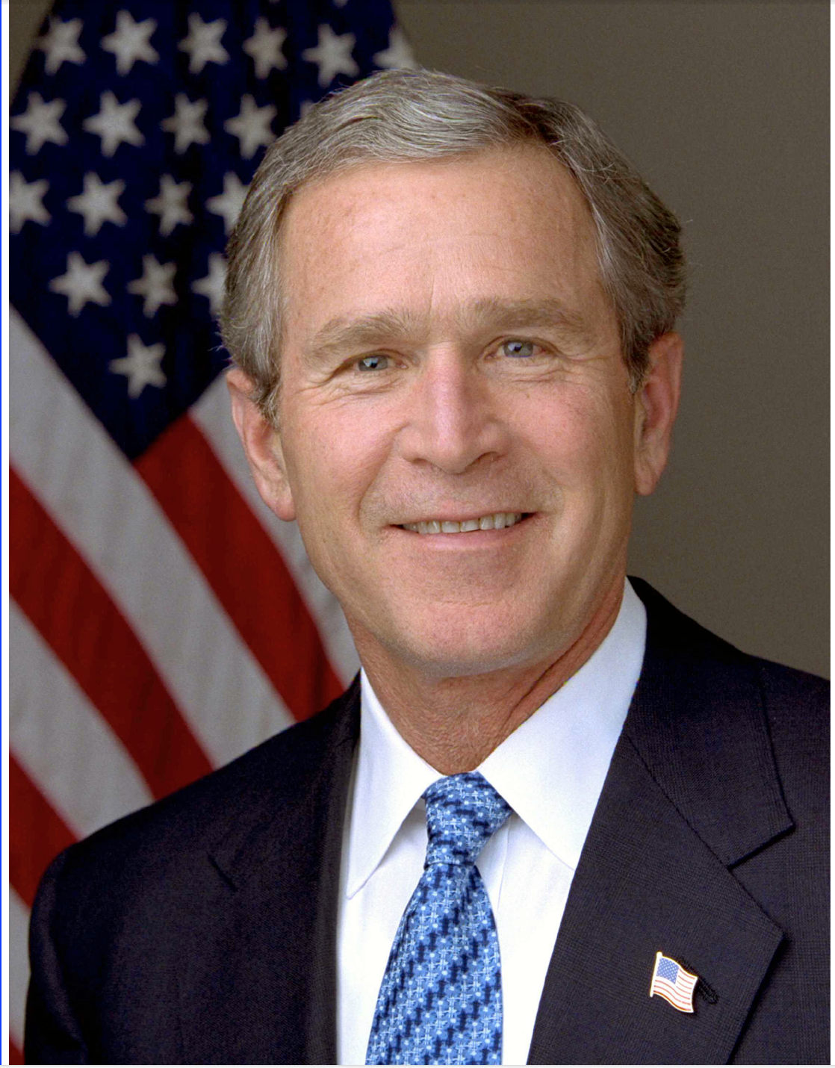
“America is addicted to oil”
State of The Union Address
Jan 31 2006
President George W. Bush
Notes:
2

Slide 3
We are addicted to:
Long life
Good health/Medical advances
Technological Progress
Affordable Services
Freedom of mobility
Abundant and affordable food
Natural landscapes
Clean Water/Air

Slide 4
Affordable Energy
Electrification
Transportation
Industry
We are addicted to:
Long life
Good health/Medical advances
Technological Progress
Affordable Services
Freedom of mobility
Abundant and affordable food
Natural landscapes
Clean Water/Air

Slide 5
Affordable Energy
Electrification
Transportation
Industry
We are addicted to:
Long life
Good health/Medical advances
Technological Progress
Affordable Services
Freedom of mobility
Abundant and affordable food
Natural landscapes
Clean Water/Air
Carbon 87%
(coal, natural gas, oil)
Nuclear 9%
Hydroelectric power 3%

Slide 6
Affordable Energy
Electrification
Transportation
Industry
We are addicted to:
Long life
Good health/Medical advances
Technological Progress
Affordable Services
Freedom of mobility
Abundant and affordable food
Natural landscapes
Clean Water/Air
Carbon 87%
(coal, natural gas, oil)
Nuclear 9%
Hydroelectric power 3%
CO2: Non-Toxic
Invigorates Biosphere
Increases food production
Climate?????

Slide 7
Today, Climate Change is
A Science Issue
A Political Issue
A Moral Issue

Slide 8
Climate Change is a Science Issue

Slide 9
All Science is Numbers
Paraphrase of Lord Kelvin
(Sir William Thomson)
Notes:
9

Slide 10
How do you test the “Settled Science” of the Administration’s view of Climate Change?
How do you prove humans are affecting the climate?

Slide 11
One attempt: Take a Climate Model Simulation and show you can reproduce the current climate only when extra CO2 is added into the model.
This is a Hypothesis – a “claim”

Slide 12
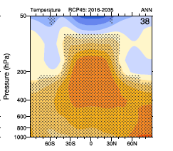
Test the Largest Signature of Global Warming that “Settled Science” (model) says is Happening
The most obvious signature of warming due to extra greenhouse gases is the temperature of the tropical troposphere
Cross section of atmosphere
50,000 ft
Tropical tropospheric “Hot Spot” is a major signature of GHG response in models
10,000 ft
Surface
S. Pole
Tropics
N. Pole

Slide 13
102 CMIP-5 rcp4.5 Model runs in 32 Groups
Tropical Mid-Tropospheric Temp. – The greenhouse “Hot Spot”
5-Year Averages, 1979-2015 Trend line crosses zero at 1979 for all time series
Observations
Circles - Avg 4 Balloon datasets
Squares- Avg 3 Satellite datasets
In Science, when we understand a system, we can predict its behavior. If not, we do not understand the system.

Slide 14
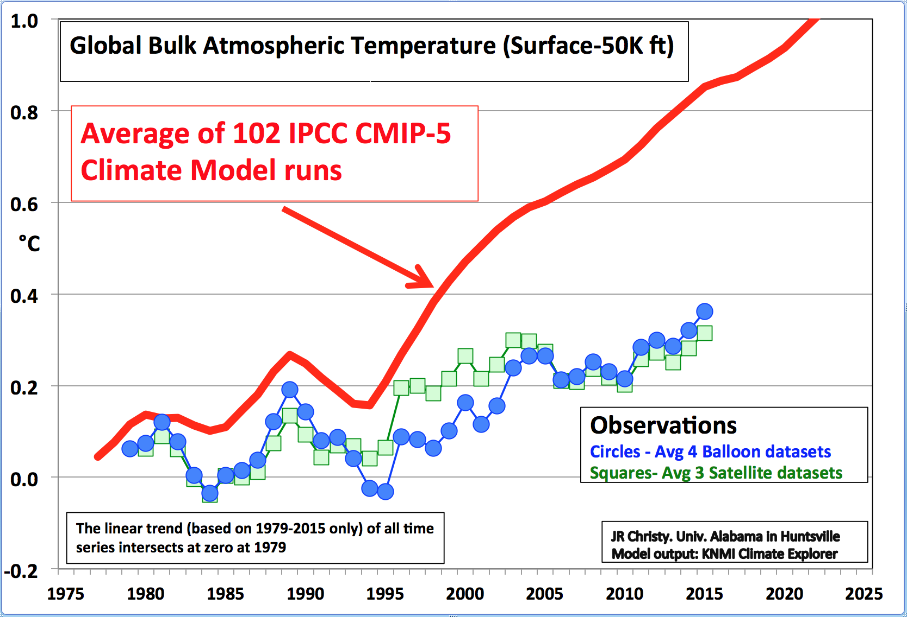

Slide 15
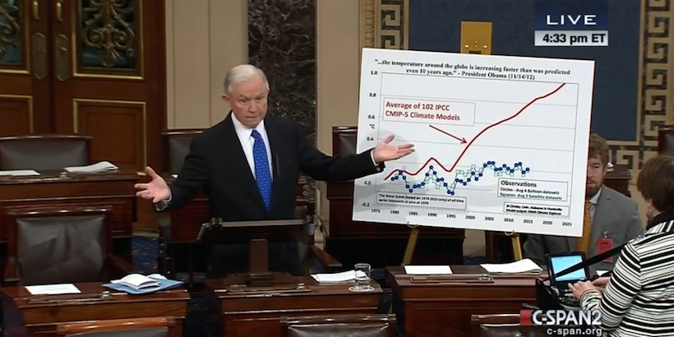
“The temperature around the globe is increasing faster than was predicted just 10 years ago”, President Obama Nov. 14 2012
Sen. Jeff Sessions Floor Speech 27 Jan 2015

Slide 16
U.S. spends $10s of millions per year for climate modelers to hit this target (the real world warming rate.)

Slide 17
This is the result.
The disturbing implication is that the current understanding of climate sensitivity to CO2 is systematically wrong – all models over predict the warming – so basic claim of “understanding” is wrong

Slide 18
Other Evidence?
Disappearing
Snow and Sea Ice

Slide 19
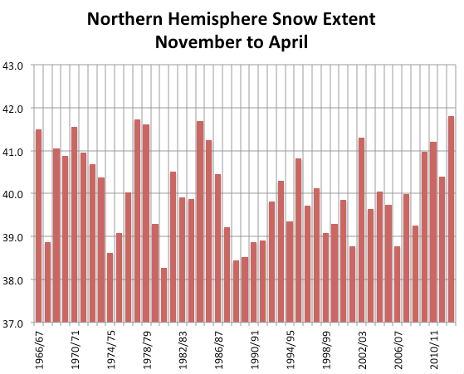
Record Coverage 2012-13
Million sq. km

Slide 20
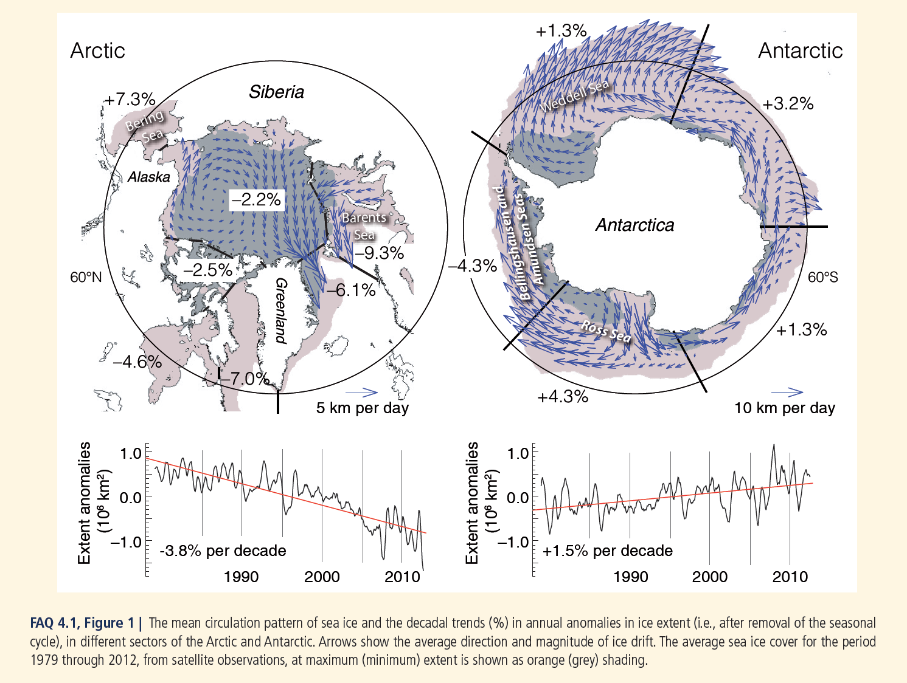
IPCC AR5 Chapter 4
Arctic Downward
Antarctic Upward
Sea Ice Changes 1979-2012

Slide 21
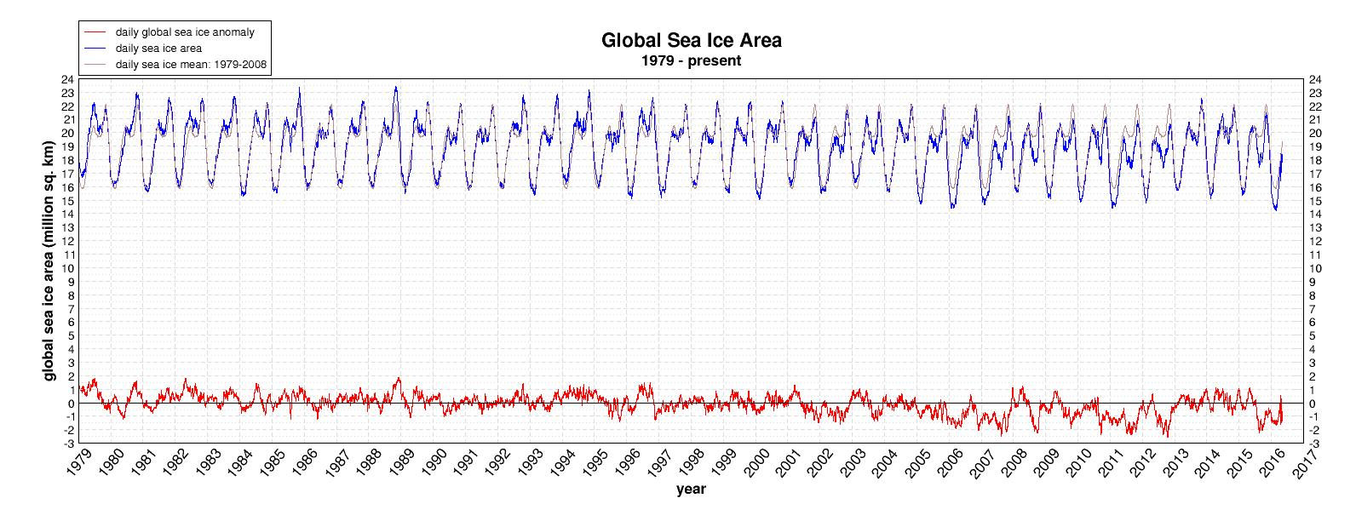
Global Sea Ice is at the long-term average as of 10 May 2016
[2014 Antarctic Sea Ice coverage has set daily records]
Cryosphere Today, Chapman, U. Illinois

Slide 22
Sea Level Rise

Slide 23
Satellite-based Sea Level 1992- 2015 (mm)
About 1 inch per decade
University of Colorado

Slide 24
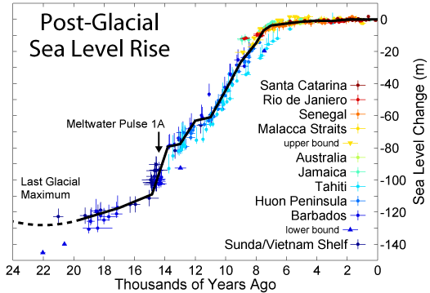
Sea Level Rises as Land-ice melts.
The major low-latitude ice-age ice sheets finished melting about 8,000 years ago (i.e. Illinois, New York, etc.) and since then the remnant mountain glaciers and parts of Greenland and Antarctica are still adding some melt-water. [The warm period 130,000 years ago saw sea levels 20 ft higher than today, i.e. naturally.]
Sea level also rises for other reasons such as increases in eroded soil material flowing into the ocean and thermal expansion of the water itself.
0.3”per decade
Last 7000 years
5”per decade 15,000 to 7000 years ago

Slide 25
Extreme Weather

Slide 26
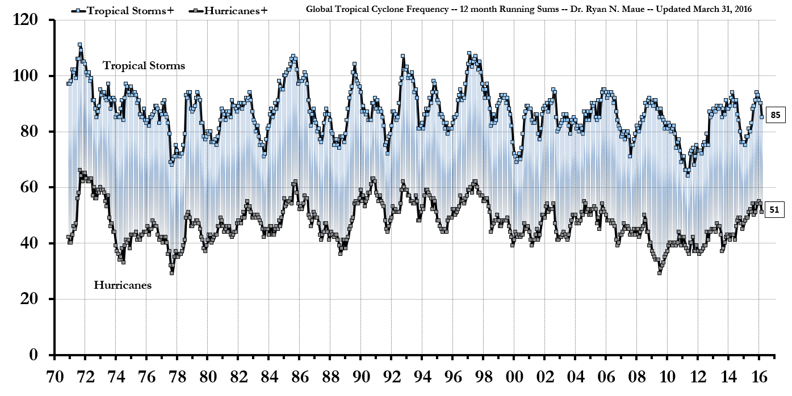
Global Hurricanes (1971 to March 2016)

Slide 27
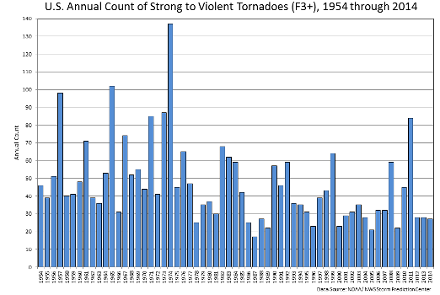

Slide 29
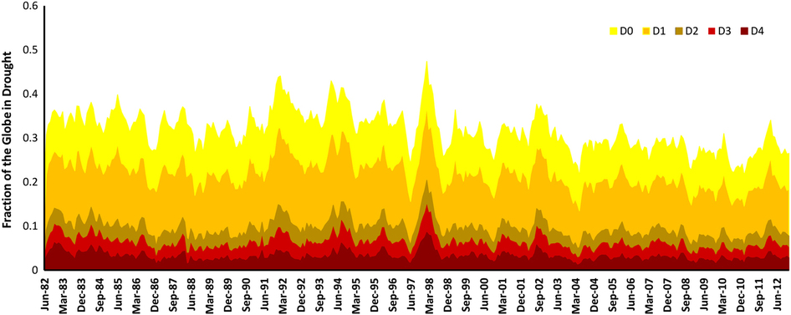
Global Drought Indices 1982-2012
Hao et al. 2014

Slide 31

Alabama Summer Daily Maximum Temperature (°F)
Average of 4, 100-mile-diameter regions centered on
MOB, MGM, BHM and HSV, 1883-2015
J. Christy Alabama State Climatologist, The University of Alabama in Huntsville
Christy and McNider 2016

Slide 32
Views of “dangerous” Climate Change rely on models that fail simple testing and are not based on the evidence we have

Slide 33
Climate Change is a Political Issue

Slide 34
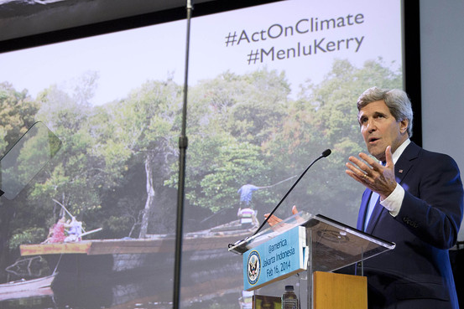
Climate Change is a Political Agenda
“The science is unequivocal, and those who refuse to believe it are simply burying their heads in the sand. We don’t have time for a meeting anywhere of the Flat Earth Society. And in a sense, climate change can now be considered another weapon of mass destruction, perhaps the world’s most fearsome weapon of mass destruction.” – John Kerry
Feb 16 2014
U.S. Secretary of State John Kerry during a speech on climate change in Jakarta on Sunday. Agence France-Presse/Getty Images

Slide 35
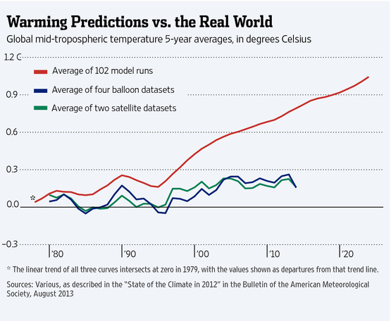
Climate Change is a Political Agenda
U.S. Secretary of State John Kerry during a speech on climate change in Jakarta on Sunday. Agence France-Presse/Getty Images

Slide 36
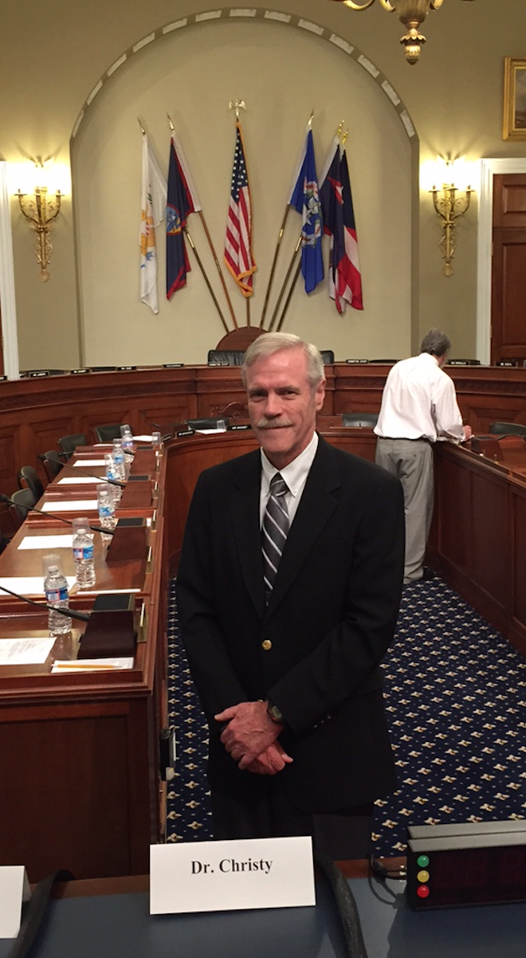
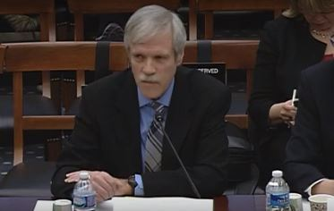
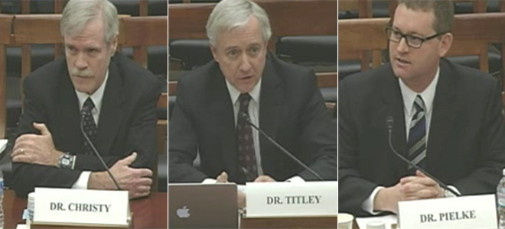
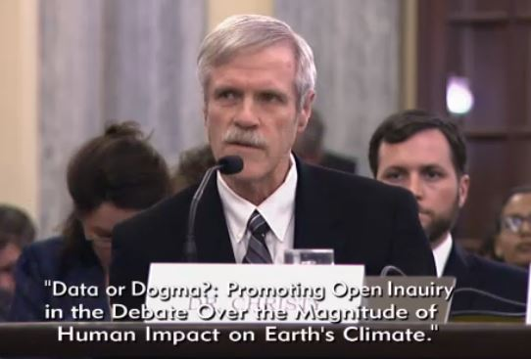
House Science, Space and Technology Committee
11 Dec 2013
House Committee on Science 2 Feb 2016
House Committee on Natural Resources
13 May 2015
Senate Commerce Committee 8 Dec 2015

Slide 37

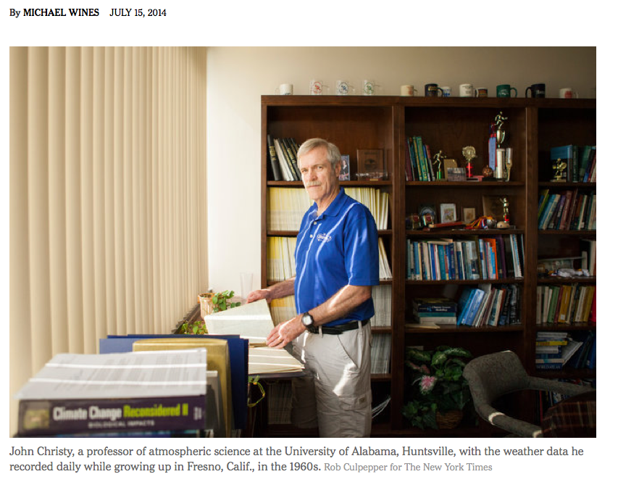
Though Scorned by Colleagues, a Climate-Change Skeptic Is Unbowed

Slide 38
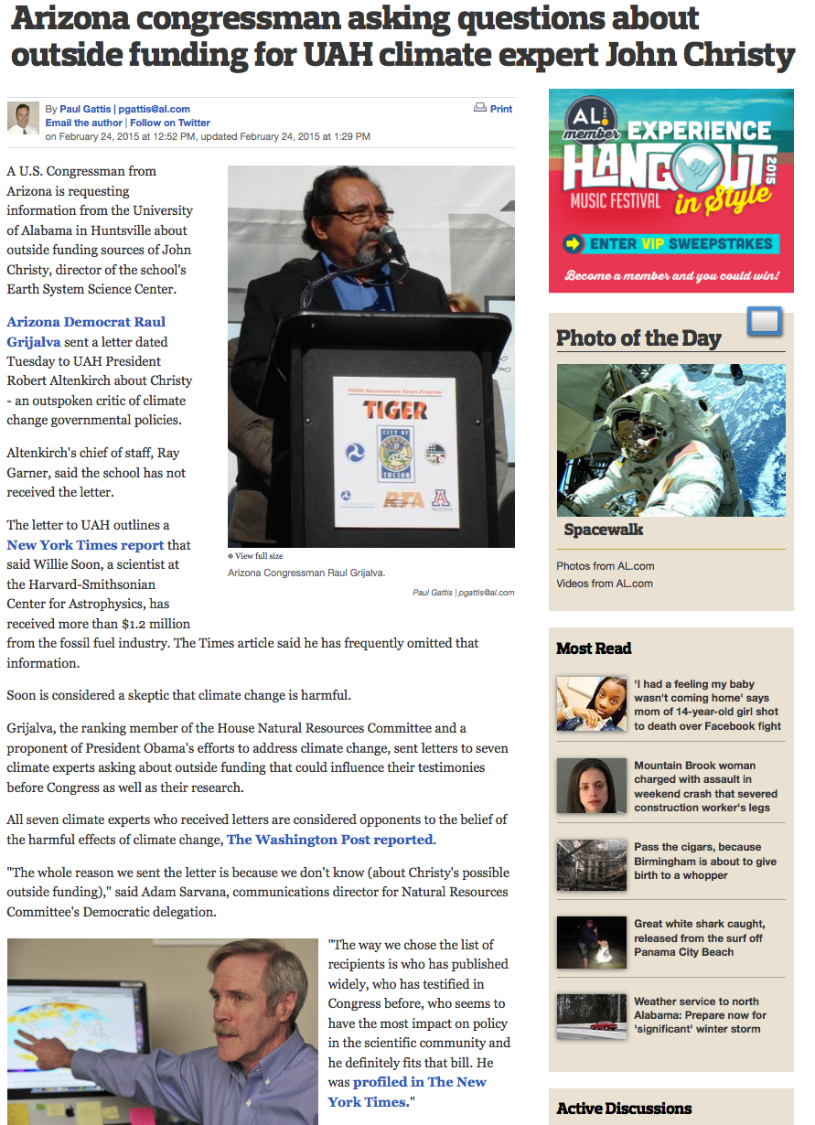
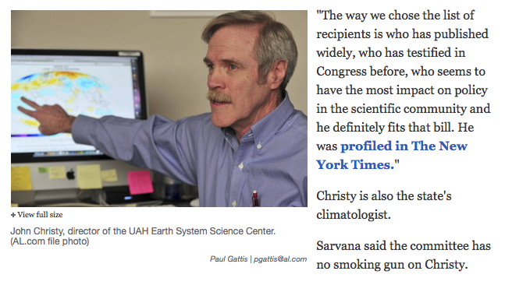
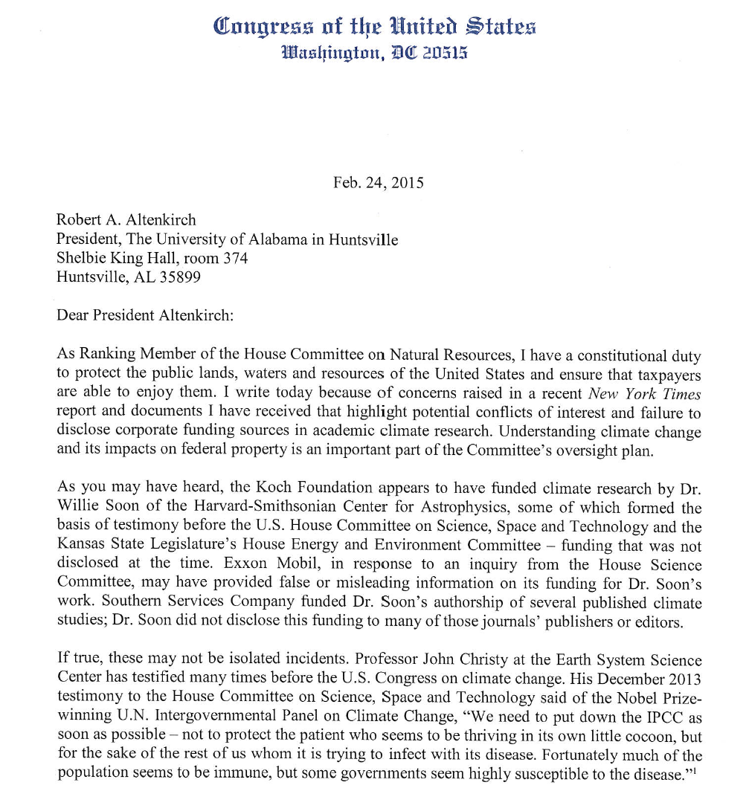

Slide 39


Tuesday May 3, 2016
Exxon climate change dissent subpoena sweeps up more than 100 U.S. institutions
“Mr. Walker is one of 17 attorneys general who announced March 29 a coalition to pursue fraud claims against companies and others disputing the climate change consensus. Sixteen of the attorneys general are Democrats, while Mr. Walker is an independent.”
“Among those listed individually on the document are MIT professor emeritus Richard Lindzen and University of Alabama at Huntsville climatologist John Christy.”

Slide 40
Tuesday May 31, 2016
Landmark California Bill (SB 1161) Would Allow Prosecution of Climate Change Skeptics
California Climate Science Truth and Accountability Act of 2016, [authorizes] prosecutors to sue fossil fuel companies, think tanks and others that have “deceived or misled the public on the risks of climate change.”
“... allowing legal action to be brought ... extending back indefinitely.”
Thursday 2 June, 2016
California sidelines bill to prosecution climate change skeptics

Slide 41
Tuesday May 31, 2016
Landmark California Bill (SB 1161) Would Allow Prosecution of Climate Change Skeptics
California Climate Science Truth and Accountability Act of 2016, [authorizes] prosecutors to sue fossil fuel companies, think tanks and others that have “deceived or misled the public on the risks of climate change.”
“... allowing legal action to be brought ... extending back indefinitely.”
Thursday 2 June, 2016
California sidelines bill to prosecution climate change skeptics

Slide 42
Will Politically-forced Regulations make a difference?

Slide 43
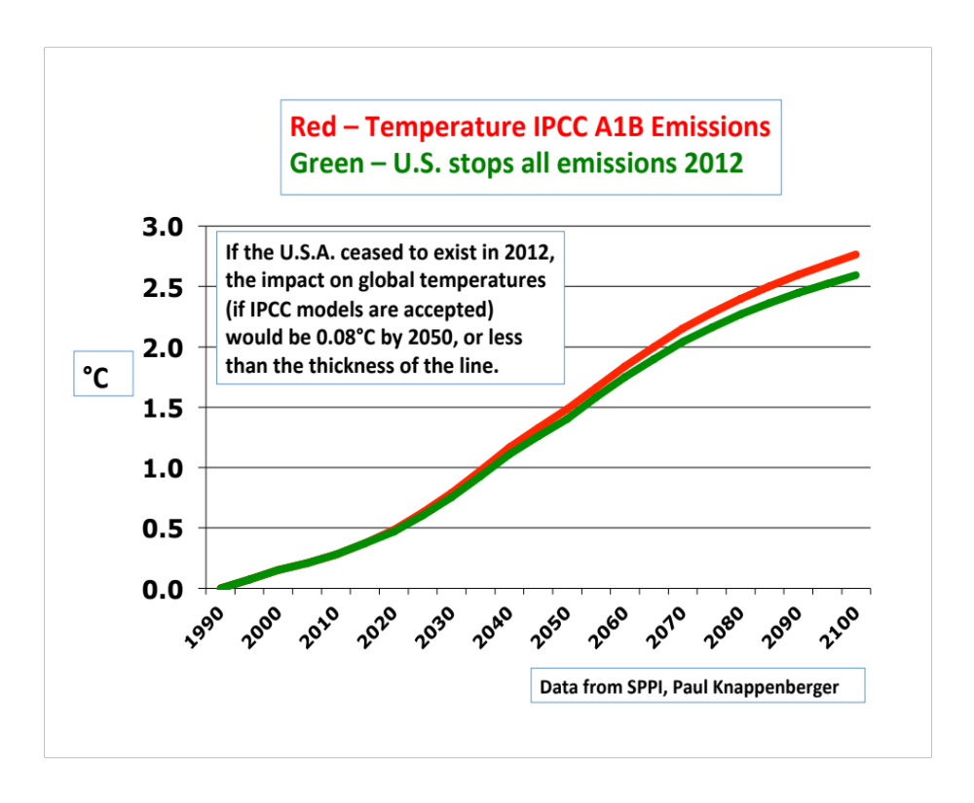
The irony is that even if you accept the latest climate model simulations, they show that the US will have little impact on whatever the temperature evolution does over the next century

Slide 44
The scientific method shows:
Regulations that impose higher energy costs will do nothing perceptible or attributable to whatever the climate is going to do

Slide 45
The Real World Happens - even in the politically-correct nations

Slide 46
Law of Sustainability
If it’s not economically sustainable, it’s not sustainable.

Slide 47
Law of Sustainability
If it’s not economically sustainable, it’s not sustainable.

Slide 48
The Real World Happens –
Germany and Japan
In an environmental push these countries changed the energy mix to utilize less carbon/nuclear and more wind and solar
Electric rates rose to $0.38/kW-hr in Germany
Electric rates rose to $0.26/kW-hr in Japan
Yet CO2 emissions in Germany and Japan are rising

Slide 49
The Real World Happens –
Germany and Japan
In an environmental push these countries changed the energy mix to utilize less carbon/nuclear and more wind and solar
Electric rates rose to $0.38/kW-hr in Germany
Electric rates rose to $0.26/kW-hr in Japan
Yet CO2 emissions in Germany and Japan are rising

Slide 50
The Real World Happens –
Germany and Japan
In an environmental push these countries changed the energy mix to utilize less carbon/nuclear and more wind and solar
Electric rates rose to $0.38/kW-hr in Germany
Electric rates rose to $0.26/kW-hr in Japan
CO2 EMISSIONS IN GERMANY AND JAPAN ARE RISING

Slide 51
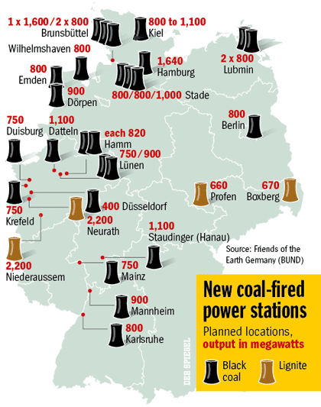
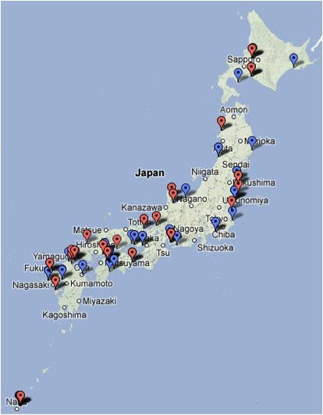
Germany is adding 26 coal-fired power plants--Stuart Burns, Metal Miner, 22 October 2013
Japan has 43 coal fired power plants under construction or planned for the dominant source of energy for electricity. Bloomberg 9 April 2015

Slide 52
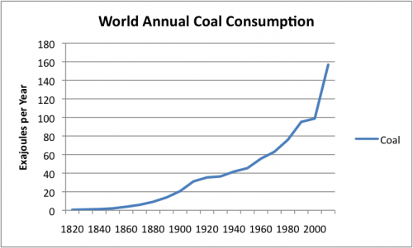
Coal – no one is following the “official” U.S. view

Slide 53
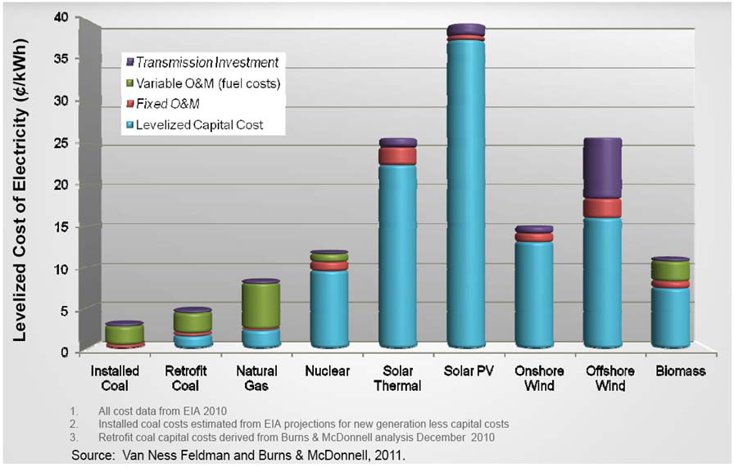
http://www.americaspower.org/sites/default/files/Social-Benefits-of-Carbon.pdf

Slide 54
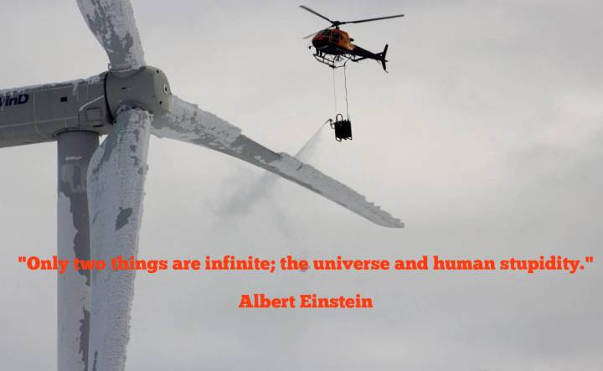
“Only two things are infinite; the Universe and human stupidity”
Albert Einstein

Slide 55
In the U.S., there are 210,000 employees in the solar energy sector and 190,000 in the coal industry.
The annual energy produced per coal industry employee is 23,800 MWh.
The annual energy produced per solar industry employee is 395 MWh.
The coal industry employee provides a return that is over 60 times that of a solar industry employee.
http://euanmearns.com/the-revealing-numbers-on-solar-employment-in-the-usa/

Slide 56
In the U.S., there are 210,000 employees in the solar energy sector and 190,000 in the coal industry.
The annual energy produced per coal industry employee is 23,800 MWh.
The annual energy produced per solar industry employee is 395 MWh.
The coal industry employee provides a return that is over 60 times that of a solar industry employee.
http://euanmearns.com/the-revealing-numbers-on-solar-employment-in-the-usa/

Slide 57
In the U.S., there are 210,000 employees in the solar energy sector and 190,000 in the coal industry.
The annual energy produced per coal industry employee is 23,800 MWh.
The annual energy produced per solar industry employee is 395 MWh.
The coal industry employee provides a return that is over 60 times that of a solar industry employee.
http://euanmearns.com/the-revealing-numbers-on-solar-employment-in-the-usa/

Slide 58
In the U.S., there are 210,000 employees in the solar energy sector and 190,000 in the coal industry.
The annual energy produced per coal industry employee is 23,800 MWh.
The annual energy produced per solar industry employee is 395 MWh.
The coal industry employee provides a return that is over 60 times that of a solar industry employee.
http://euanmearns.com/the-revealing-numbers-on-solar-employment-in-the-usa/

Slide 59
Climate Change is a Moral Issue
What is the value of human life?

Slide 60
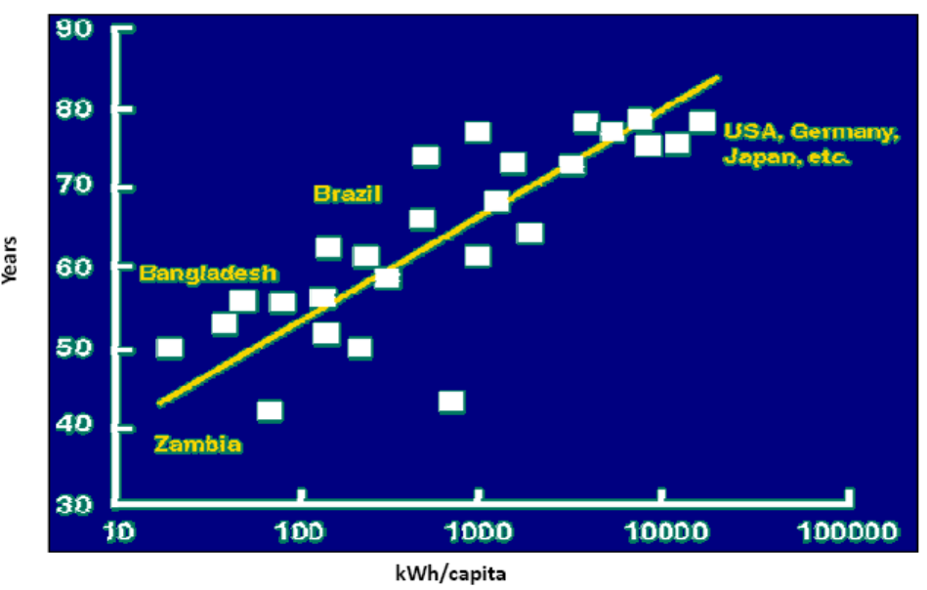
http://www.americaspower.org/sites/default/files/Social-Benefits-of-Carbon.pdf
A high value on Human Life means moving people up on on the energy curve
Source: World Resources Institute, IEEE Spectrum

Slide 61
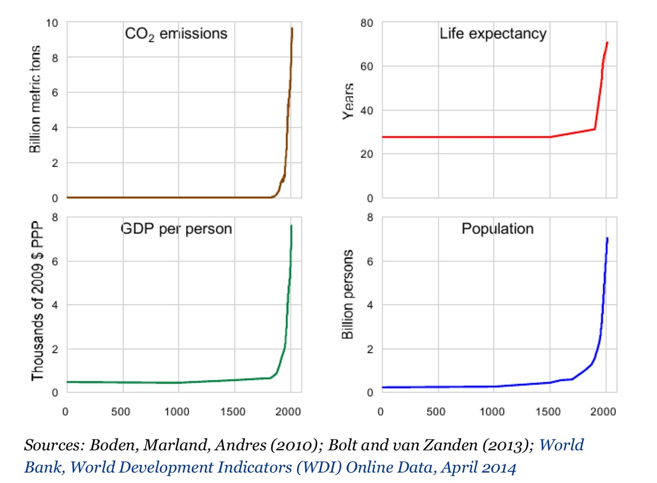

Slide 62
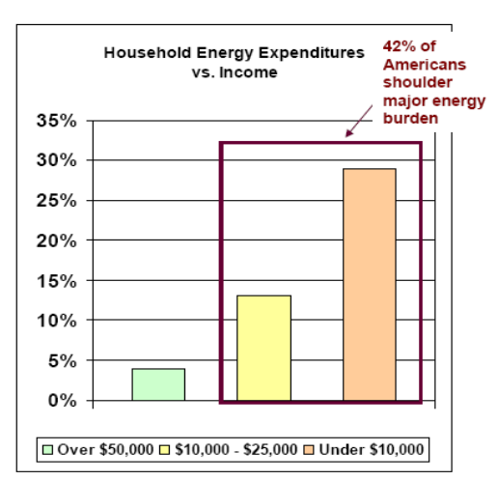
http://www.americaspower.org/sites/default/files/Social-Benefits-of-Carbon.pdf
Helping the poor means lowering energy costs
Hurting the poor means increasing energy costs
Source: American Association of Blacks in Energy

Slide 63
The Real World Happens – Developing World
Affordable energy vastly improves the quality and length of human life
The most affordable path to energy today is carbon combustion
U.S. share of world CO2 emissions has fallen from 28 percent in 1990s to 16 percent today to 13 percent by 2040.

Slide 64
The Real World Happens – Developing World
Affordable energy vastly improves the quality and length of human life
The most affordable path to energy today is carbon combustion
U.S. share of world CO2 emissions has fallen from 28 percent in 1990s to 16 percent today to 13 percent by 2040.

Slide 65




Kenya, East Africa
Notes:
65

Slide 66



Energy System
Energy Source
Energy Transmission
Energy Use
To value human life means avoiding this energy system
Notes:
66

Slide 67
CO2 Emissions EIA 2013 Outlook
(million metric tons CO2)
Pushing electrons produces longer and better lives
2013: US 16.5% total global emissions
2025: US 14.1%
2040: US 12.5%
China broke ground on 66 coal plants in 2015
India 148 new coal plants under construction in Dec 2015
http://www.eia.gov/oiaf/aeo/tablebrowser/#release=IEO2013&subject=0-IEO2013&table=10-IEO2013&region=0-0&cases=Reference-d041117

Slide 68
The Real World Happens – Developing World
Affordable energy vastly improves the quality and length of human life
The most affordable path to energy today is carbon combustion
U.S. share of world CO2 emissions has fallen from 28 percent in 1990s to 16 percent today to 13 percent by 2040.

Slide 69
Affordable Energy
Electrification
Transportation
Industry
We are addicted to:
Long life
Good health/Medical advances
Technological Progress
Affordable Services
Freedom of mobility
Abundant and affordable food
Natural landscapes
Clean Water/Air
Carbon 87%
(coal, natural gas, oil)
Nuclear 9%
Hydroelectric power 3%
CO2: Non-toxic
Invigorates Biosphere
Increases food production
Basis for Human Progress
Climate?????
Without energy, life is brutal and short

Slide 70
Law of Sustainability
What [CO2] cuts? That’s for more developed countries. The moral principle of historic responsibility cannot be washed away. India’s first task is eradication of poverty. Twenty percent of our population doesn’t have access to electricity, and that’s our top priority. We will grow faster, and our CO2 emissions will rise.
--Indian Environment Minister Prakash Javadekar, The New York Times 24 September 2014

Slide 71
Law of Sustainability
If it’s not economically sustainable, it’s not sustainable.
Lifting people out of energy poverty with carbon (today) is morally right and is going to keep happening everywhere else no matter what the U.S. does

Slide 72
Law of Sustainability
If it’s not economically sustainable, it’s not sustainable.
Lifting people out of energy poverty with carbon (today) is morally right and is going to keep happening everywhere else no matter what the U.S. does

Slide 73
What do the numbers show?
The scientific method demonstrates the current theory of CO2 warming of the climate is out of step with reality.
The extreme weather events we care about are not increasing in frequency or intensity.
Punitive regulatory controls will do essentially nothing to change whatever the climate is going to do.
CO2-emitting Coal is increasingly powering the world’s economies, including Germany’s and Japan’s along with developing countries, no matter what the U.S. says.

Slide 74
What do the numbers show?
The scientific method demonstrates the current theory of CO2 warming of the climate is out of step with reality.
The extreme weather events we care about are not increasing in frequency or intensity.
Punitive regulatory controls will do essentially nothing to change whatever the climate is going to do.
CO2-emitting Coal is increasingly powering the world’s economies, including Germany’s and Japan’s along with developing countries, no matter what the U.S. says.

Slide 75
What do the numbers show?
The scientific method demonstrates the current theory of CO2 warming of the climate is out of step with reality.
The extreme weather events we care about are not increasing in frequency or intensity.
Punitive regulatory controls will do essentially nothing to change whatever the climate is going to do.
CO2-emitting Coal is increasingly powering the world’s economies, including Germany’s and Japan’s along with developing countries, no matter what the U.S. says.

Slide 76
What do the numbers show?
The scientific method demonstrates the current theory of CO2 warming of the climate is out of step with reality.
The extreme weather events we care about are not increasing in frequency or intensity.
Punitive regulatory controls will do essentially nothing to change whatever the climate is going to do.
CO2-emitting Coal is increasingly powering the world’s economies, including Germany’s and Japan’s along with developing countries, no matter what the U.S. says.

Slide 77
What does my experience say?
Climate Change is a political issue and there is a cost for those of us who are not politically correct
If there is value in enhancing the quality and length of human life, the moral imperative is to expand access to that which is available today: low-cost, carbon-based energy. This is happening anyway.

Slide 78
What does my experience say?
Climate Change is a political issue and there is a cost for those of us who are not politically correct
If there is value in enhancing the quality and length of human life, the moral imperative is to expand access to that which is available today: low-cost, carbon-based energy. This is happening anyway.

Slide 79
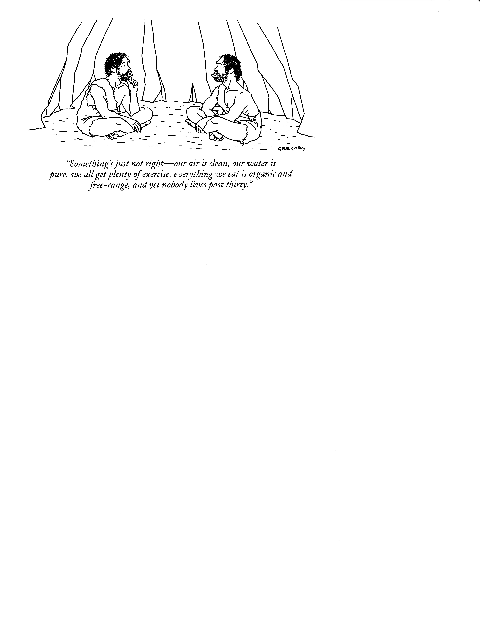
Notes:
79

Slide 81
Alabama is in a desperate fight with the Regulatory activities of the Federal Government regarding
“Climate Change”
EPA rules on CO2 will further increase cost of energy and will not affect the climate [SCOTUS issued a Stay earlier this year]

Slide 82
Alabama is in a desperate fight with the Regulatory activities of the Federal Government regarding
“Climate Change”
EPA rules on CO2 will further increase cost of energy and will not affect the climate [SCOTUS issued a Stay earlier this year]

Slide 83
Alabama Factoid
Alabama generates 152.9 million MW-hrs of electricity
Alabama consumes 86.2 million MW-hrs of electricity
Alabama exports 66.7 million MW-hrs to neighbors who buy them (GA, TN mainly).
California generates 199.5 million MW-hrs of electricity
California consumes 259.5 millions MW-hrs of electricity
California imports 60.0 million MW-hrs from neighbors

Slide 84
California overlooked the real world
Force a limit on emissions of Light Duty Vehicles
California AB 1493 seeks to reduce tail-pipe emissions of CO2 by 26% by 2016
11 NE States adopted AB 1493
Trial in Federal Court (Burlington VT) to address the engineering, legal and climate issues of AB 1493, April-May 2007

Slide 85
IPCC “Best Estimate”

Slide 86
California AB 1493
26% CO2 reduction LDV 2016
Notes:
86

Slide 87
The temperature impact on global temperatures if the entire world adopted AB 1493 is an undetectable 0.03°C.
Latest sensitivity results suggest the impact is even smaller.

Slide 88
Judge William Sessions III Ruling 12 Sept 2007
AB 1493 is legal
Pg 46
“Plaintiffs’ expert Dr. Christy estimated that implementing the regulations across the entire United States would reduce global temperature by about 1/100th (.01) of a degree by 2100. Hansen did not contradict that testimony.”

Slide 89
… is better than this Energy System
Energy Source
Energy Transmission
Energy Use
Notes:
89

